Slide 1

Using Bioinformatics to Study Genetic Disorders
Bio 300/CMPSC 300
Spring 2016
Chapter 1

Slide 2
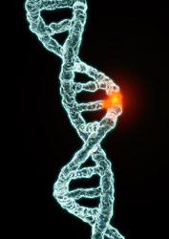
Genetic Disorder
a disorder/disease with a genetic component
caused by one or more abnormalities in the genome
  substitutions
  insertions
  deletions
  rearrangements

Slide 3
Genetic Disorder
a disorder/disease with a genetic component
caused by one or more abnormalities in the genome
single gene disorders
  mutation(s) in the sequence of a single gene
  alters or eliminates protein product

Slide 4
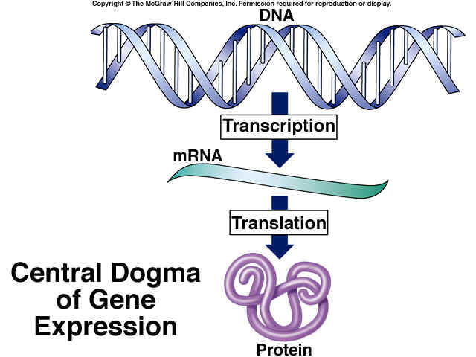
Central Dogma of Gene Expression

Slide 5
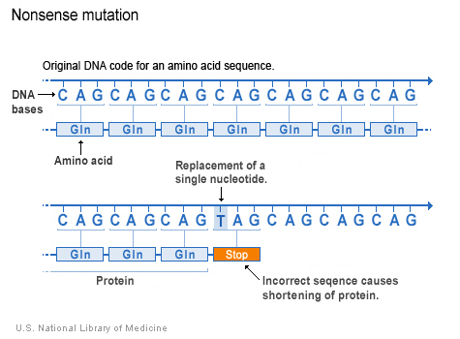
Mutations and Their Potential Effects
Mutations that Alter Protein Products
Mutations that Eliminate Protein Products
Missense substitutions
Nonsense substitutions
Insertions/Deletions
Missense substitutions
Nonsense substitutions
Insertions/Deletions

Slide 6
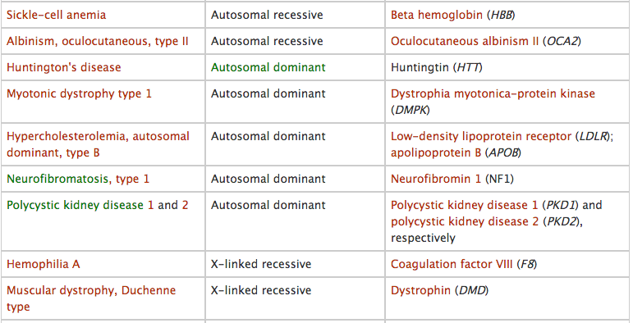
Single Gene Disorders
http://www.nature.com/scitable/topicpage/rare-genetic-disorders-learning-about-genetic-disease-979

Slide 7
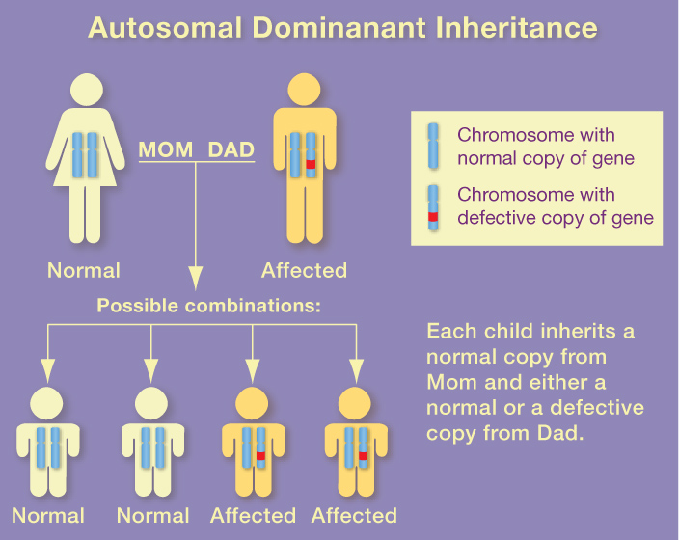

Slide 8
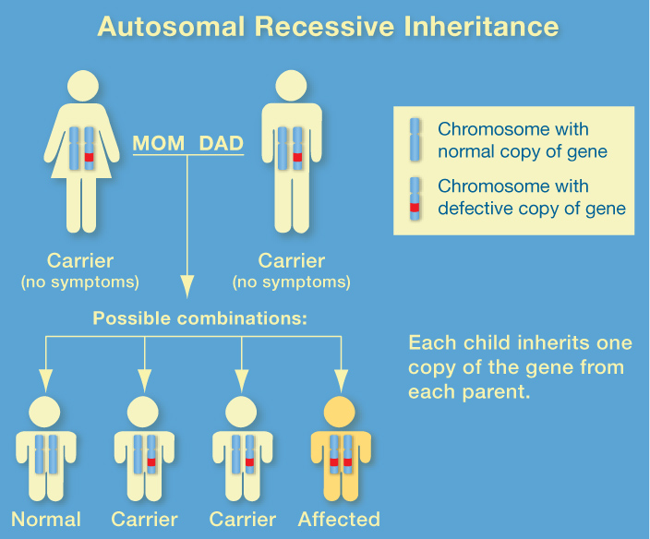

Slide 9
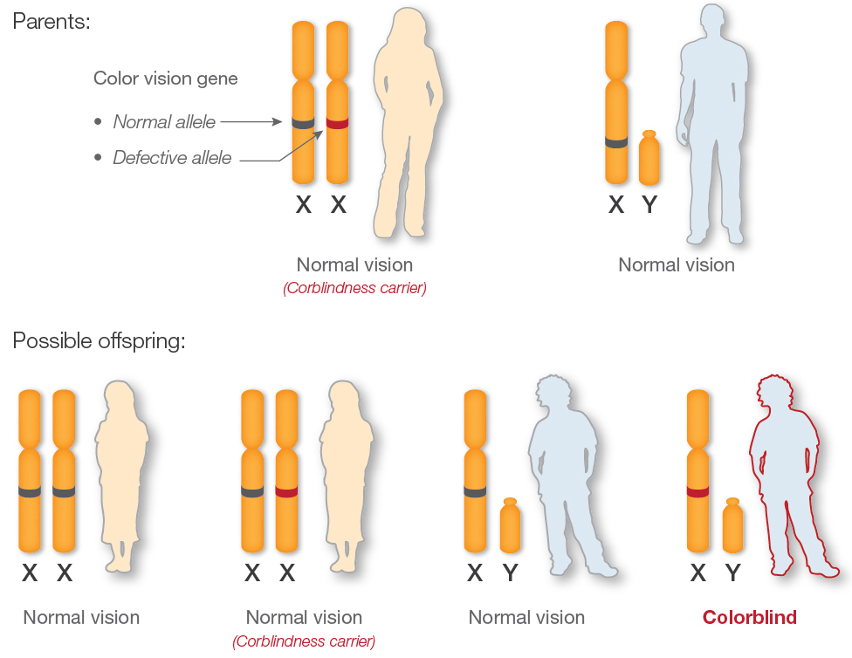
X- linked Inheritance

Slide 10
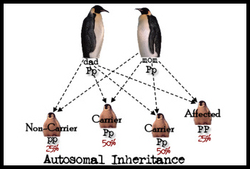
Single Gene Disorders
Inheritance patterns relatively simple
Chance of inheritance in the text generation can be predicted by studying patterns in past generations.

Slide 11
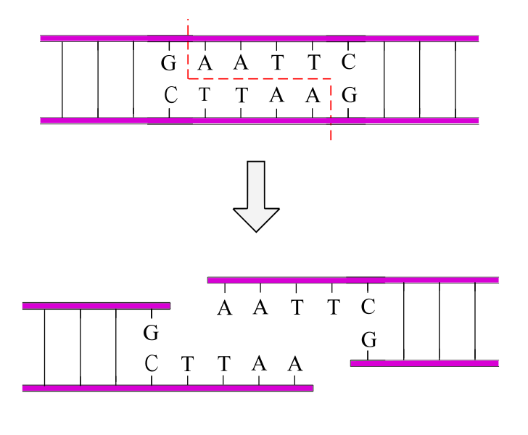
Single Gene Disorders
Most genes identified in the 1980s-1990s
  Pre-Bioinformatics
Restriction Digest Analysis
  Restriction enzymes
    cut DNA at specific sequence
  100s of different patterns

Slide 12
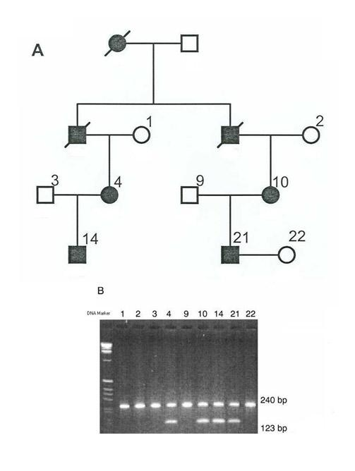
Single Gene Disorders
Pedigree analysis + Restriction Digest Analysis

Slide 13
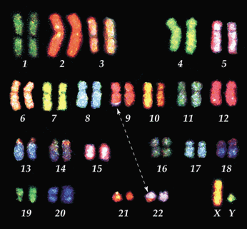
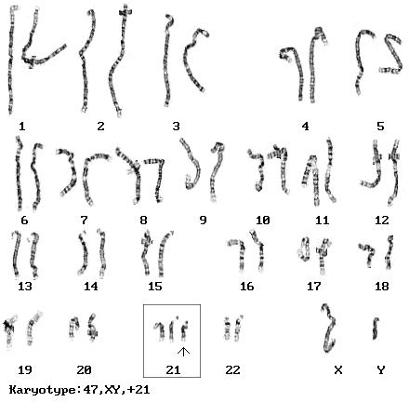
Single Gene Disorders
Cytogenetics
field of biology concerned with mapping genes to specific locations on chromosomes

Slide 14
Genetic Disorder
a disease with a genetic component
caused by one or more abnormalities in the genome
complex or multifactorial disorders
  do not have a single genetic cause
  likely associated with the effects of multiple genes in combination with lifestyle and environmental factors
  do not have a clear cut pattern of inheritance

Slide 15
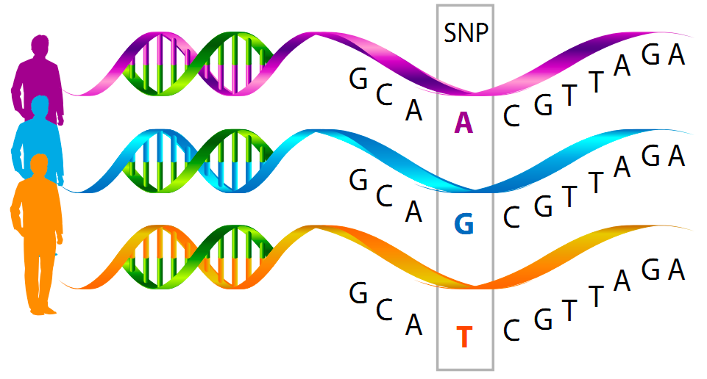
Genome-Wide Association Studies
new technology/analysis - early 2000s
  bioinformatics
screen 1000s of genomes at once for SNPs
  single nucleotide polymorphisms

Slide 16
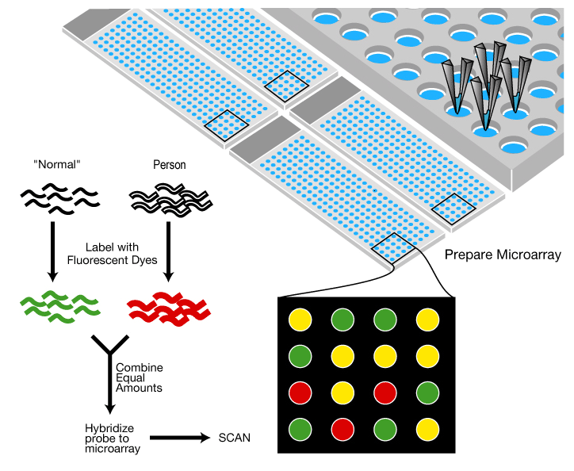
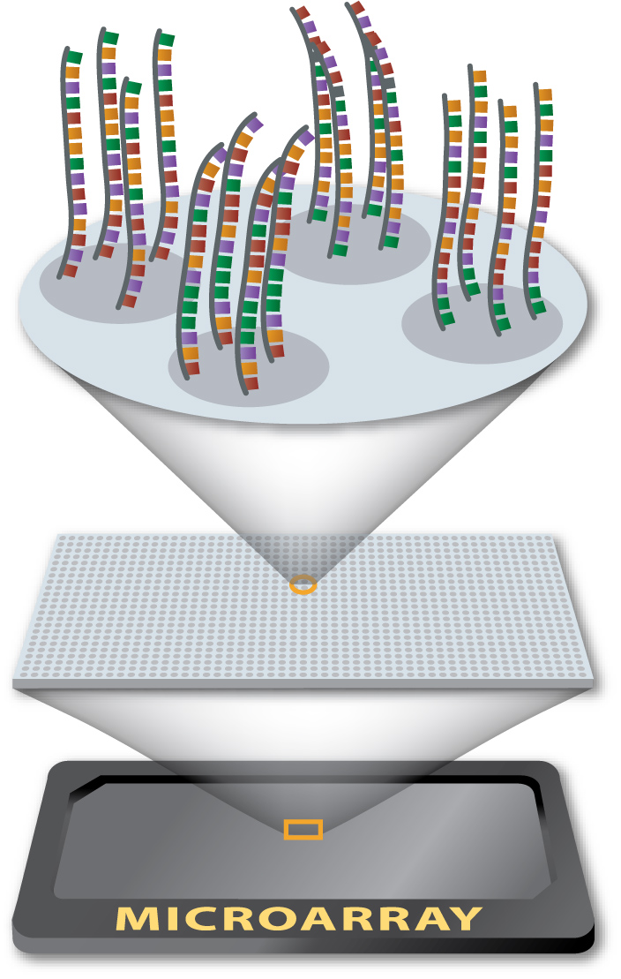
DNA Microarray
“Disease”

Slide 17
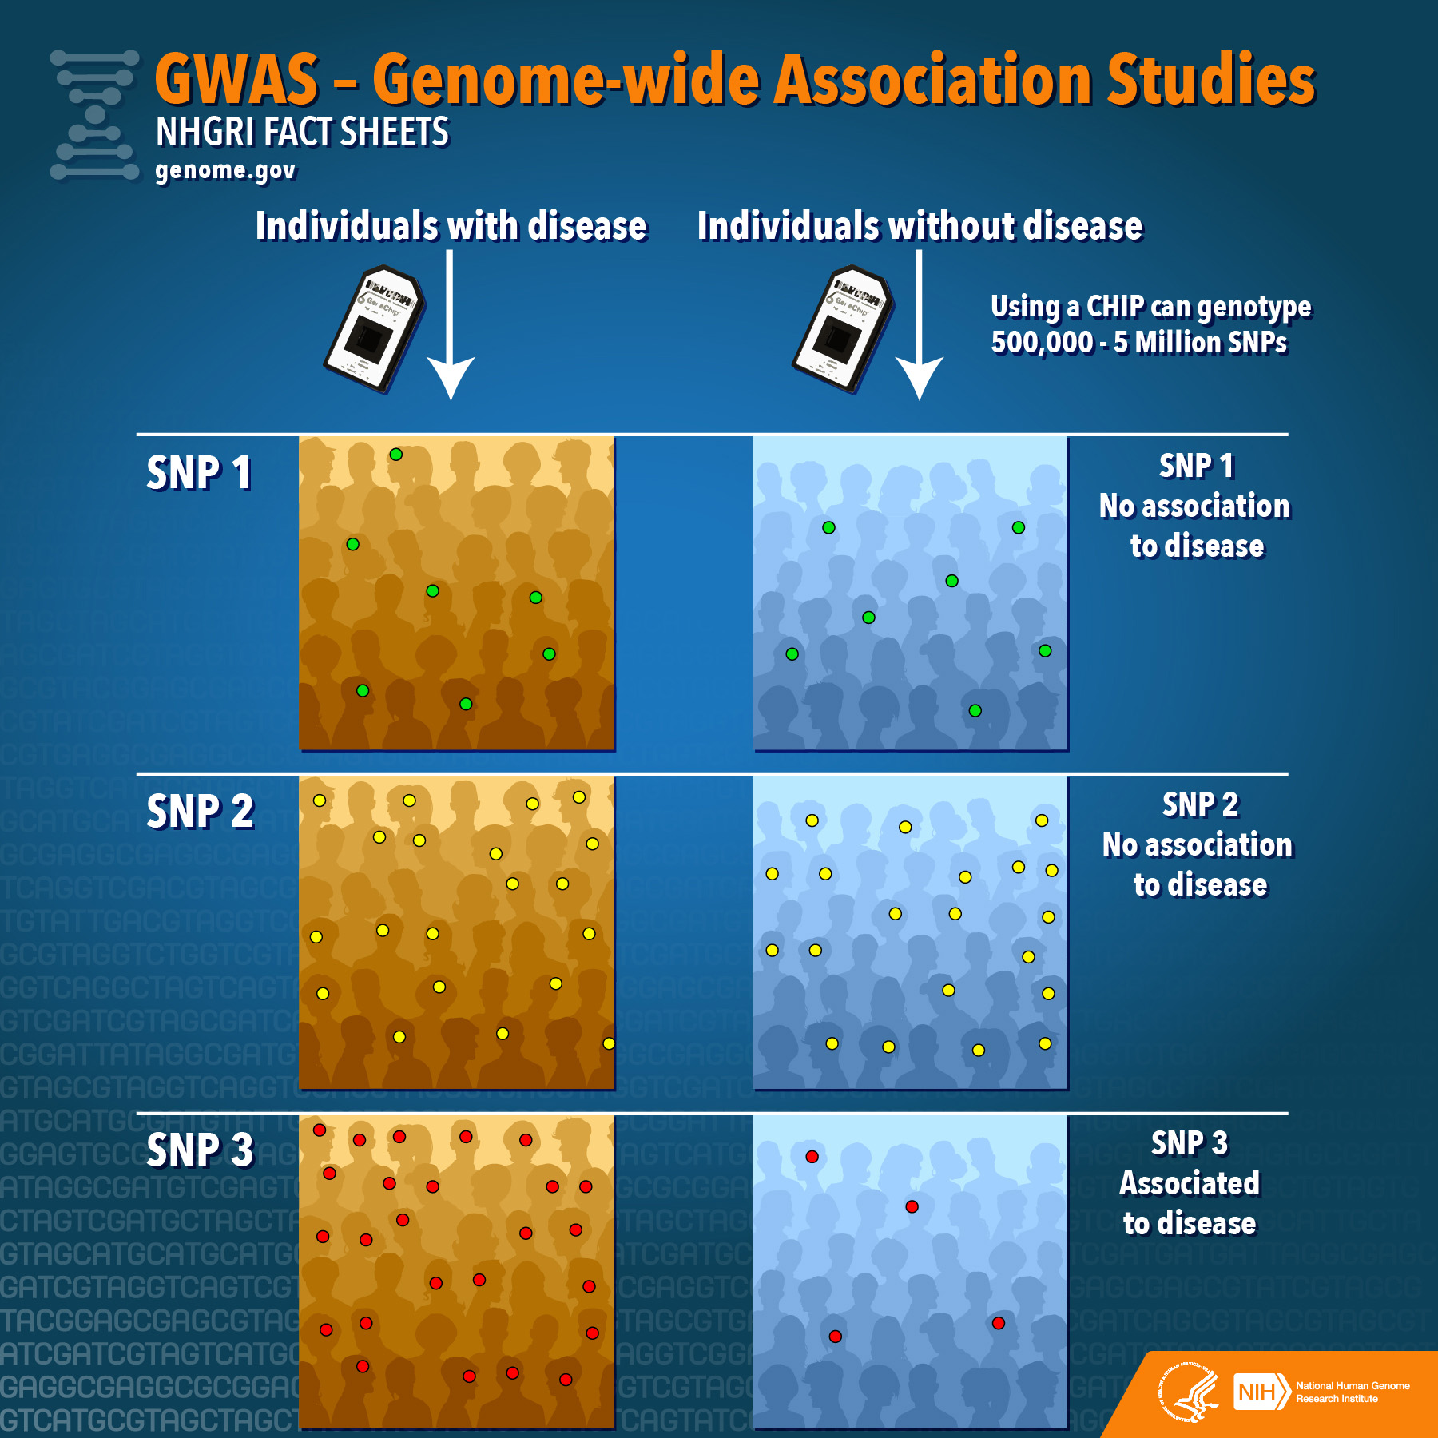

Slide 18
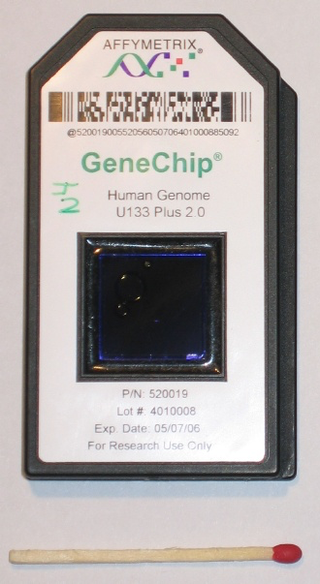
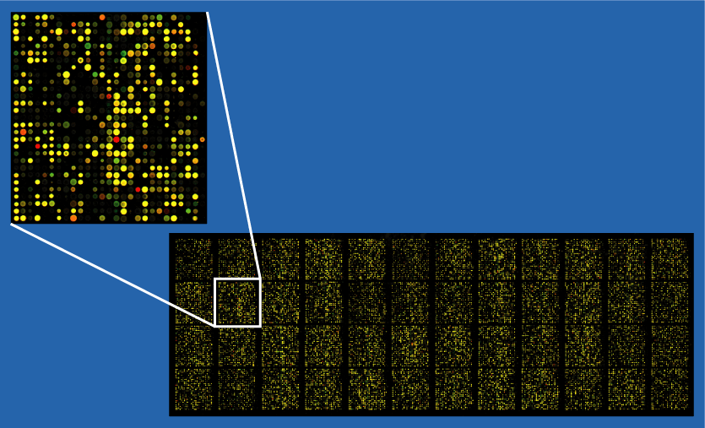
DNA Microarray

Slide 19
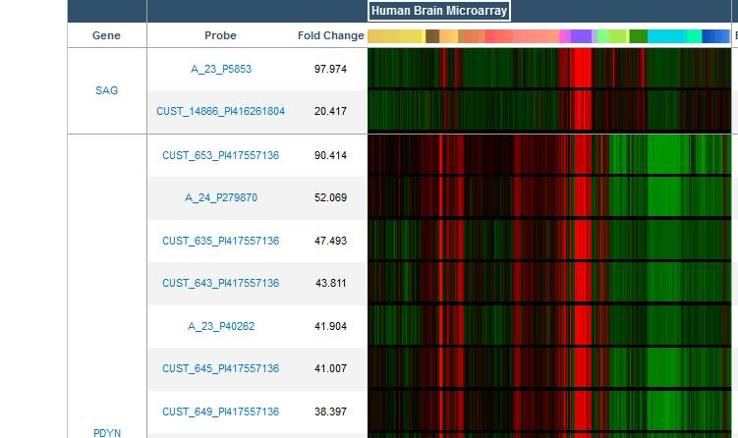
DNA Microarray

Slide 20
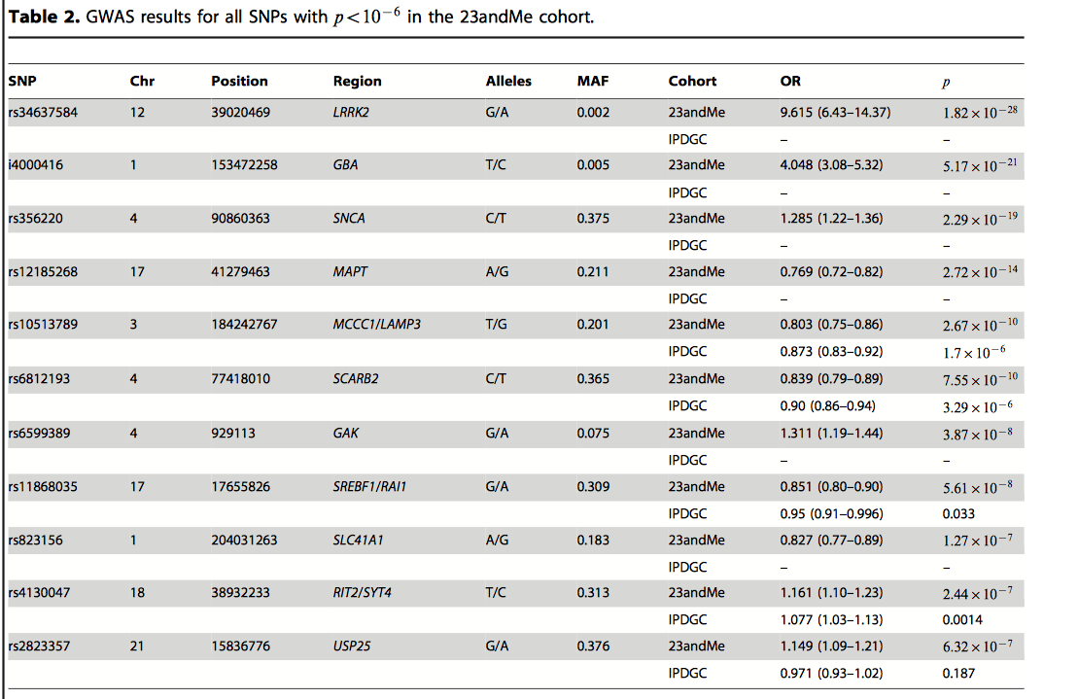
Candidate SNPs that May Be Correlated with Disorder

